Slide 1
4M12: Partial Differential Equations
Peter Davidson
Lecture 6 (of 7)
Inverting (or Solving) Poisson’s Equation
Key point:
Topics for this lecture:
1. Two examples of Poisson’s equation
2. The Biot-Savart law: a special case of inversion
3. Generalizing the Biot-Savart law to any Poisson equation
4. An aside: Poisson’s equation is often a wave-bearing system with ‘fast waves’ ignored or ‘filtered out’
Poisson’s equation:
Usually S(x) is known and want to find u. How do we invert (or solve) this PDE for u?

Slide 2
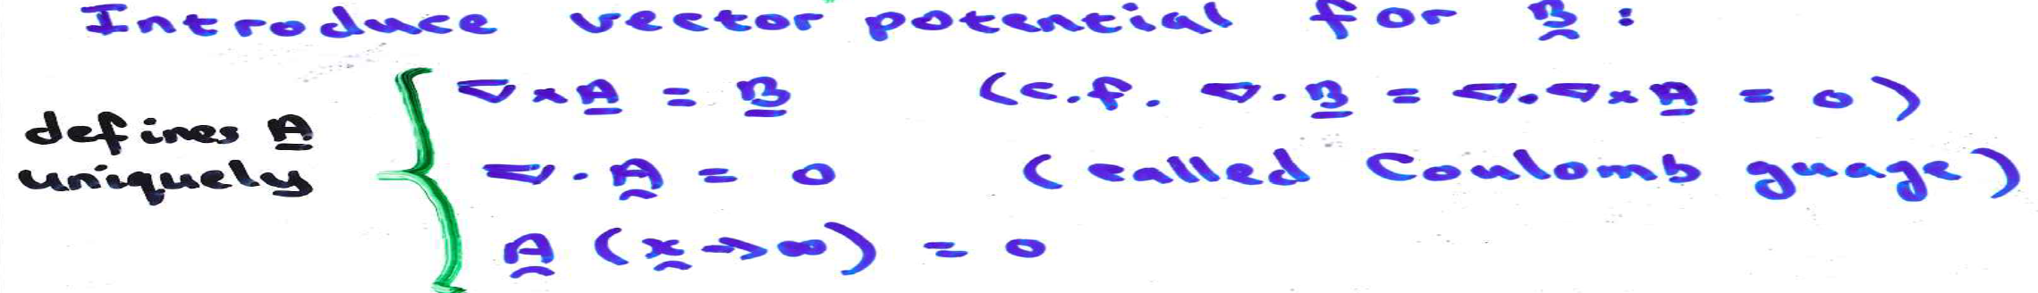
1. Two Examples of Poisson’s Equation
Back to IB E&M
A trick from IB Vect. Calc.
From Ampère to Poisson’s equ.
→
Need to invert equation to find A, and hence B.

Slide 3
p(x)
……….(1)
div(1)
Given u(x), need to invert to find p(x)

Slide 4
2. The Biot-Savart Law: a Special Case of Inversion
Biot-Savart states:
(Messy but useful.)
Can we generalize this inversion rule?

Slide 5
3. Generalizing the Biot-Savart Law to all Poisson Equations
By symmetry, u is spherically symmetric
(in an infinite domain)

Slide 6
3. Generalizing the Biot-Savart Law to all Poisson Equations, Cont…
Chop up all of space into tiny cubes dV and replace S(x) by a delta function at the centre of each cube of strength S(x’)dV. Now apply superposition.
←

Slide 7
3. Generalizing the Biot-Savart Law to all Poisson Equations, Cont…
(see examples paper for details)

Slide 8
3. Generalizing the Biot-Savart Law to all Poisson Equations, Cont…
…

Slide 9
4. Poisson’s Equation Often Represents a Wave-bearing
System where ‘Fast Waves’ have been ‘Filtered Out’

Slide 10
4. Poisson’s Equation Often Represents a Wave-bearing
System where ‘Fast Waves’ are ‘Filtered Out’, Cont…
Quasi-steady approximation ‘filters out’ these EM waves by taking c → ∞. More on this in next lecture.

